Slide 1
Fuzzy Min-Max Neural Networks Clustering
Abstract- It is a unsupervised learning pattern clustering sibling called the fuzzy min-max clustering neural network is presented. Pattern clusters are implemented here as fuzzy sets using a membership function with a hyperbox core that is constructed from a min point and a max point.
The min-max points are determined using the fuzzy min-max learning algorithm, an expansion-contraction process
it provides the ability to incorporate new data and add new clusters without retraining; and it inherently provides degree of membership information that is extremely useful in higher level decision making and information processing.
Notes:
Compare degrees of memberships in k-means and fuzzy c-means

Slide 2
Fuzzy Min-Max Neural Networks Clustering
The fuzzy min-max clustering neural network is constructed using hyperbox fuzzy sets. A hyperbox defines a region of the n-dimensional pattern space, and all patterns contained within the hyperbox have full cluster membership.
A hyperbox is completely defined by its min point and its max point.
The combination of the min-max points and the
hyperbox membership function defines a fuzzy set (cluster)
Learning in the fuzzy min-max clustering neural network consists of creating and adjusting hyperboxes in pattern space as they are received.

Slide 3
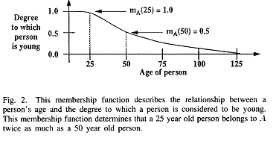
Fuzzy Min-Max Neural Networks Clustering

Slide 4
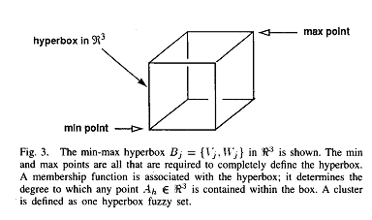
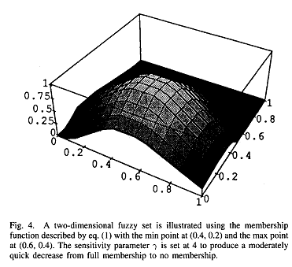
Fuzzy Min-Max Neural Networks Clustering

Slide 5
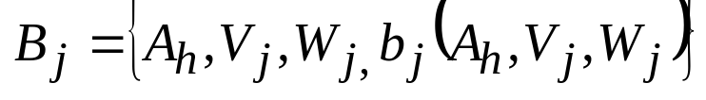



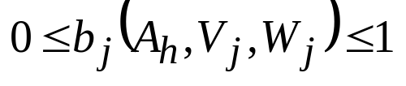
Fuzzy Min-Max clustering
Let the jth hyperbox fuzzy set, B,, be defined by the ordered
set
For all h = 1,2,….,m, where
is the hth pattem in the data set,
is the min point for the jth hyperbox and
is max point for the jth hyperbox, and the membership function for the jth hyperbox is
The function measures the degree to which the hth input pattem Ah falls within the hyperbox formed by the min point V, and the max point W

Slide 6
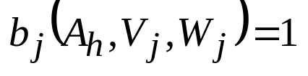
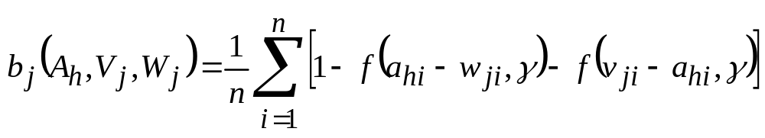
Fuzzy Min-Max clustering
On a dimension-by-dimension basis, this can be considered a measurement of how far each component is greater (less) than the max (min) point value along each dimension that falls outside the min-max bounds of the hyperbox.
As A_{h} approaches the hyperbox,
The function that meets all these criteria is the complement of the average amount of max point violations and the average amount of min point violations. The resulting membership function (shown in Fig. for two-dimensions) is defined as

Slide 7
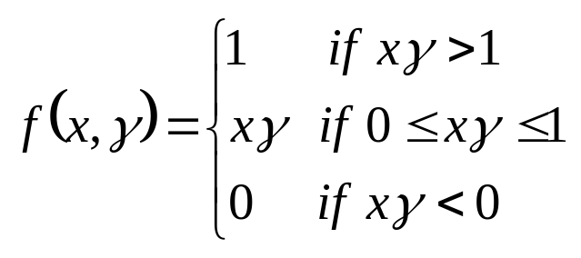

Fuzzy Min-Max clustering
where f() is the two-parameter ramp threshold function
The parameter is the sensitivity parameter that regulates how fast the membership values- decrease when an input pattem is separated from the hyperbox core.
When is large, the fuzzy set becomes more crisp, and when is small the fuzzy set becomes less crisp.

Slide 8


Fuzzy MIN-MAX Clustering
Learning in the fuzzy min-max clustering neural network is an expansion contraction process. Assume the training set is defined as
where
The learning process begins by selecting an ordered pair from A and finding the closest hyperbox to that pattern that can expand (if necessary) to include the pattern.

Slide 9
Fuzzy Min-Max Clustering
Fuzzy Min-Max Learning four-step process:
The fuzzy min-max classification learning algorithm is a
Initialization: Initialize all the min-max points prior to any learning.
Expansion: Identify the hyperbox closest to the input pattern th can be expanded and expand it. If an expandable hyperbox cannot be found, add a new hyperbox
Overlap Test: Determine whether the recent expansion caused any overlap between hyperboxes.
Contraction: If the expansion test identified any over-lapping hyperboxes, contract the hyperboxes to eliminate the overlap.

Slide 10







Fuzzy Min-Max Clustering
Hyperbox Expansion: Given a pattern , find the hyperbox
that provides the highest degree of membership and allows expansion (if needed). The degree of membership is measured using (1). The maximum size of a hyperbox is bounded by , a
user-defined value. For the hyperbox to expand to include,
the following constraint must be met:

Slide 11
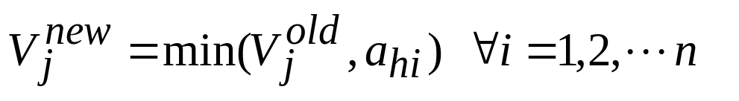
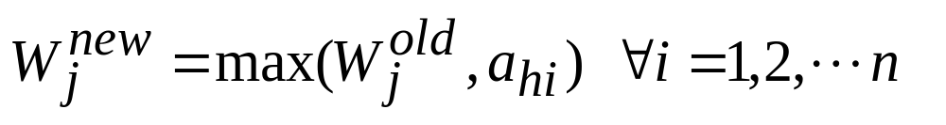
Fuzzy Min-Max Clustering
If the above Eqn is satisfied, the min point of the hyperbox is adjusted using the equation
and the max point is adjusted using the equation

Slide 12
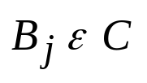
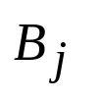
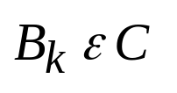
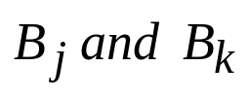
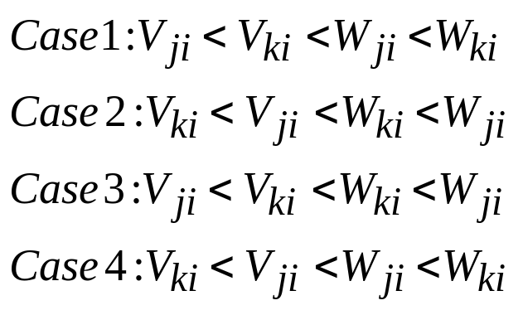
Hyperbox Overlap Test: Assume that the hyperbox is expanded in the previous step.
To determine overlap, a dimension-by-dimension comparison is conducted between
and the remaining
The expansion creates an overlap between
if one of the four cases is satisfied for
each of the n dimensions

Slide 13
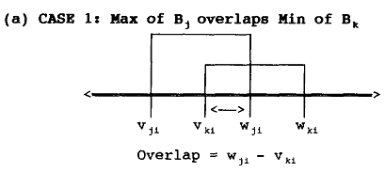
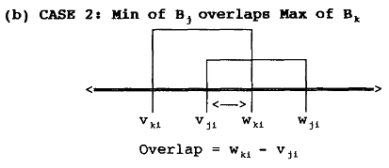
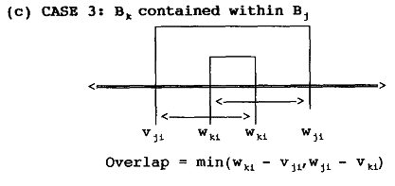
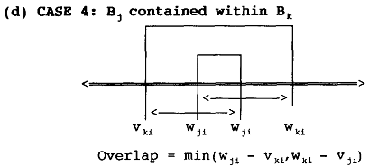
The four cases that occur during overlap testing. Each graph shows the relative values of two hyperboxes along one dimension.

Slide 14
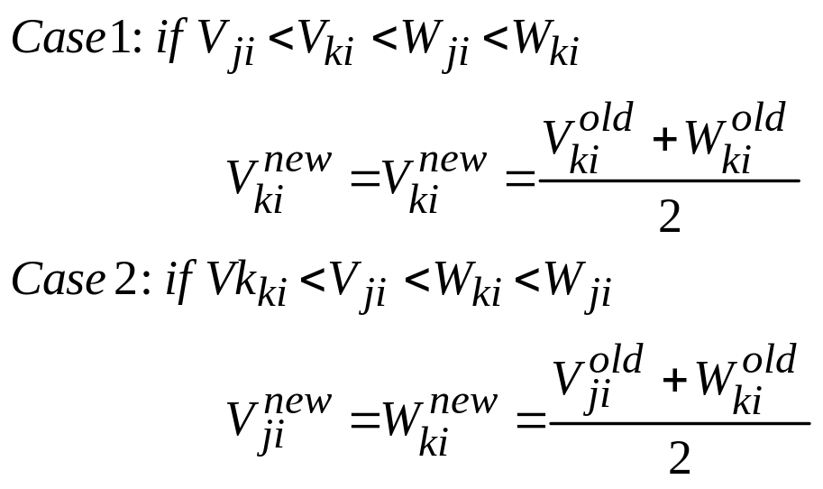
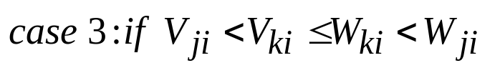

Hyperbox Contraction: If the hyperboxes
are overlapping, the overlap is eliminated on a dimension-by- dimension basis. Using the four cases previously described, the overlapping hyperboxes are contracted as follows:
then the contraction is performed on the smaller of the two overlaps.
then contract using the assignment

Slide 15
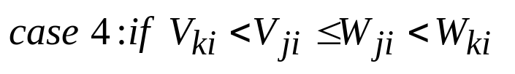
then, by symmetry, the same assignments under the same conditions in case 3 are applied here
Here, the clusters are adjusted to eliminate overlap in every dimension so that the resulting clusters are more compact
Steps 1-4 are repeated for each pattern in the data set until
cluster stability is achieved.
Cluster stability is defined as all hyperbox min and max points not changing during successive presentations of the data set in the same order.

Slide 16
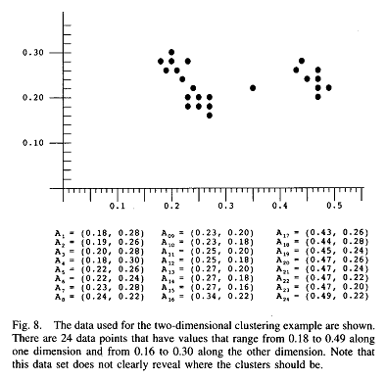
Fuzzy Min-Max Clustering

Slide 17
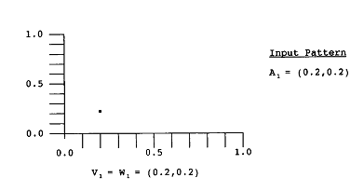
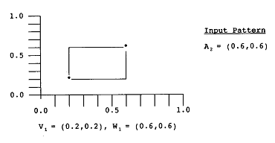
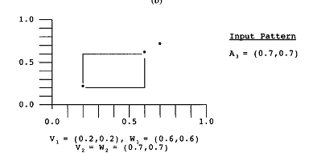
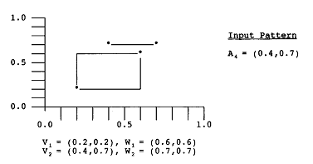

Slide 18
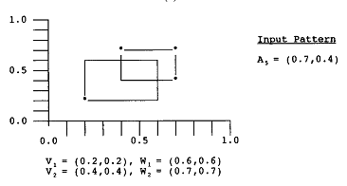
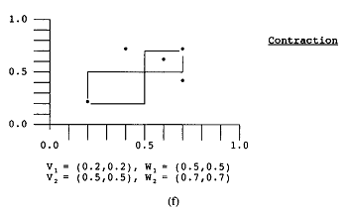

Slide 19

An example illustrating the fuzzy min-max clustering learning algorithm for a set of two-dimensional data is shown. The maximum hyperbox size is The storage sequence is as follows.
  (a) Initially, there are no hyperboxes, so the first input pattern, A1 = (0.2.0.2) creates a set of min and max connections 1; = 1.t; = (0.2.0.2) for the hyperbox bl
  The second input pattern, A2 = (0.0, 0.0), is able to fit in an expanded B1 hyperbox so B1 is expanded to create the new hyperbox with the min-max points V1=(0.2.0.2) and W1= (0.6.0.6)
  The third input pattern, A3 = (0.7.0.7) will not fit into an expanded B1 hyperbox, so it is used to create a new hyperbox B2 with the min-max points
  V2, = W2= (0.7.0.7)

Slide 20
An example illustrating the fuzzy min-max clustering learning algorithm for a set of two-dimensional data is shown. The maximum hyperbox size is The storage sequence is as follows.
  (d) Initially, there are no hyperboxes, so the first input The fourth input pattern, A4 = (0.4,0.7), is closest to Bl, but it cannot be expanded to include this new point.
  The next closest hyperbox B2 can expand to include A4 resulting in the min-max points V2= (0.4.0.4) and W2=(0.7,0.7)
  The input pattern A5 is found to be closest to B1, which cannot expand, and is then found to be the next closest to B2. which causes B2 to expand, resulting in the min-max points. V2=(0.4.0.4) and W2=(0.7,0.7) Up to this point, there has not been any hyperbox overlap, but now there is. Using the equations of contraction

Slide 21
An example illustrating the fuzzy min-max clustering learning algorithm for a set of two-dimensional data is shown. The maximum hyperbox size is The storage sequence is as follows.
  Using the equations of contraction
  V1= (0.2.0.2) W1=(0.5.0.5) and ,
  V2=(0.5.0.5).W2= (0.7.0.7)

